Slide 1


Slide 2
WEB DEVELOPMENT G10

Slide 3
WEB DEVELOPMENT G10
OUR TEAM
Yusuf Chowdhury
Leader
Provide technical leadership to teammates through coaching and mentorship. Has the ability to delegate tasks; analyse and resolve technical and application problems.
Marium Anghbee
Technical Expert & Developer
Provide specific web development knowledge or expertise to the team. Responsible for the website’s performance and capacity.
Hana Hassan
Designer & Developer
Responsible for creating the design and layout of a web pages. Designing visual imagery for websites and ensuring the web page is performing as it should.
Mahriya Zahid
Designer & Developer
Responsible for designing the layout, usability, and visual appearance of the web pages. Responsible for building and maintaining the core structure of a website.

Slide 4
WEB DEVELOPMENT G10
AIM OF THIS PROJECT

Slide 5
WEB DEVELOPMENT G10
RESULTS FROM INTERVIEW

Slide 6

WEB DEVELOPMENT G10
RESOURCES / SQUARESPACE
For personal profile pages, our group had a look at Squarespace templates.
We liked the look of a clean, stylish page, which makes it clear which individual’s page it is with Large text, a regular color scheme, and a centered profile picture.
ShaynaLakshi(squarespace.com)

Slide 7
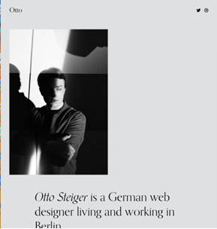

WEB DEVELOPMENT G10
RESOURCES / SQUARESPACE
We also liked this even simpler, more minimalistic design that could showcase each of our own profiles. We especially liked how the “About” and “Project” subtitles were presented, as this would work well for our presentation of linking our Coursework 1 and 2.
Otto (squarespace.com)

Slide 8
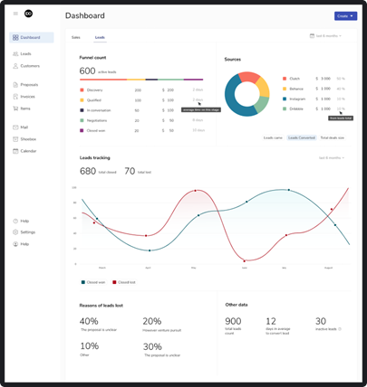
WEB DEVELOPMENT G10
RESOURCES / SQUARESPACE
For our dashboard/statistics page, we wanted something clean, eye-catching and cohesive. We are currently thinking of something that looks like this. For our actual graphs and visualisations of data we may use canvas or excel spreadsheets to customise the look and feel, before including them on our dashboard page.

Slide 9
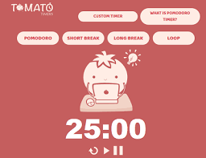
WEB DEVELOPMENT G10
RESOURCES / SQUARESPACE
For our timer page, we are currently thinking of taking inspiration from already existing productivity timer apps and utilising that to create an enhanced productivity feature that times an individual for a specific task.

Slide 10
WEB DEVELOPMENT G10
LIST OF FUNCTIONALITIES
The functionalities of the time management tool
A HTML form where a user can choose from a drop-down list of tasks
An input label for time (taken in hours and minutes)
An input label for which date on a calendar, and should only be able to submit for current day or past days
Should color co ordinate the tasks when they show up in the dashboard (e.g. “studying” would be pastel green)
The functionalities of the timer
Must be easy to use
start/stop button
easy to set timer using minutes/hours/seconds
easy to input which task is being completed using a drop down
Sound when timer finishes
A congratulations message when task is completed
A way to finish the timer early/cancel task
Reset timer function
System perspective
Must be able to store the times that have been inputted (how long the timer was on before it was stopped/finished) and store it accordingly for each task

Slide 11
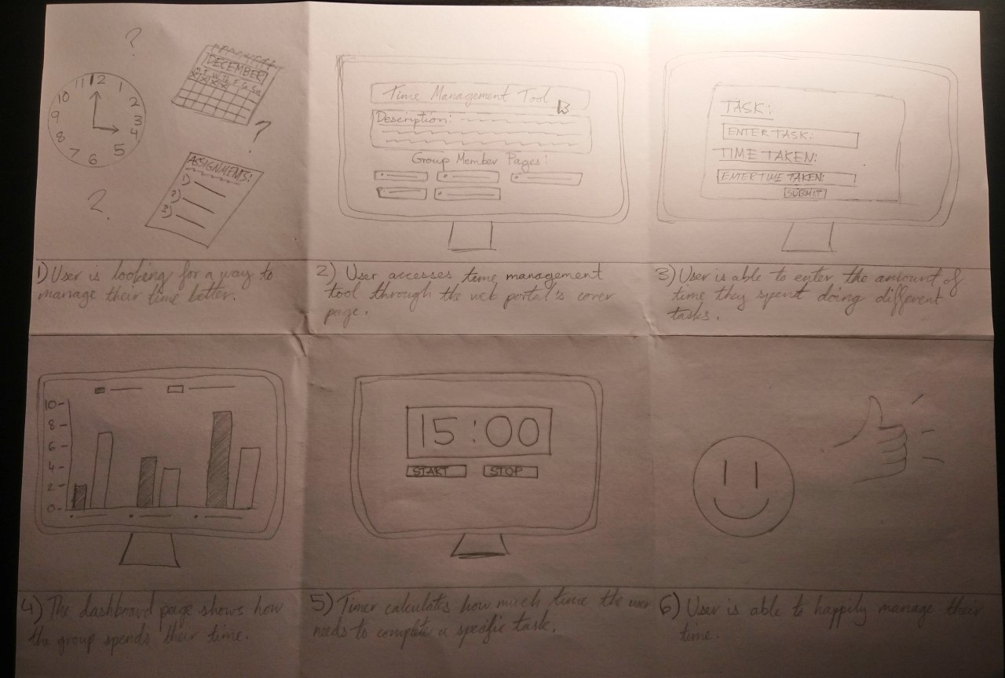
WEB DEVELOPMENT G10
STORYBOARD

Slide 12
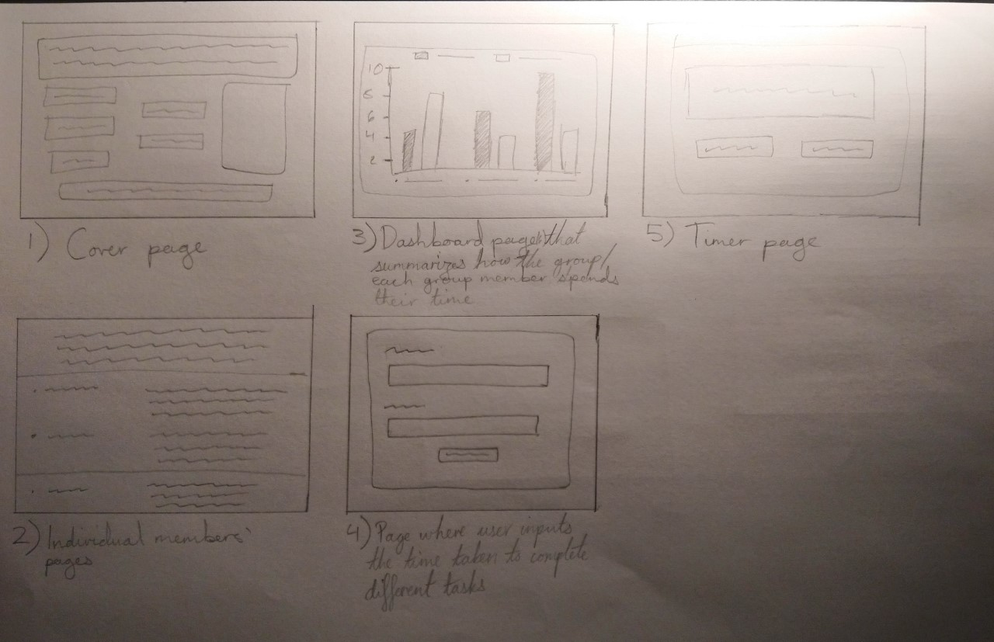
WEB DEVELOPMENT G10
WIREFRAME/PROTOTYPE

Slide 13
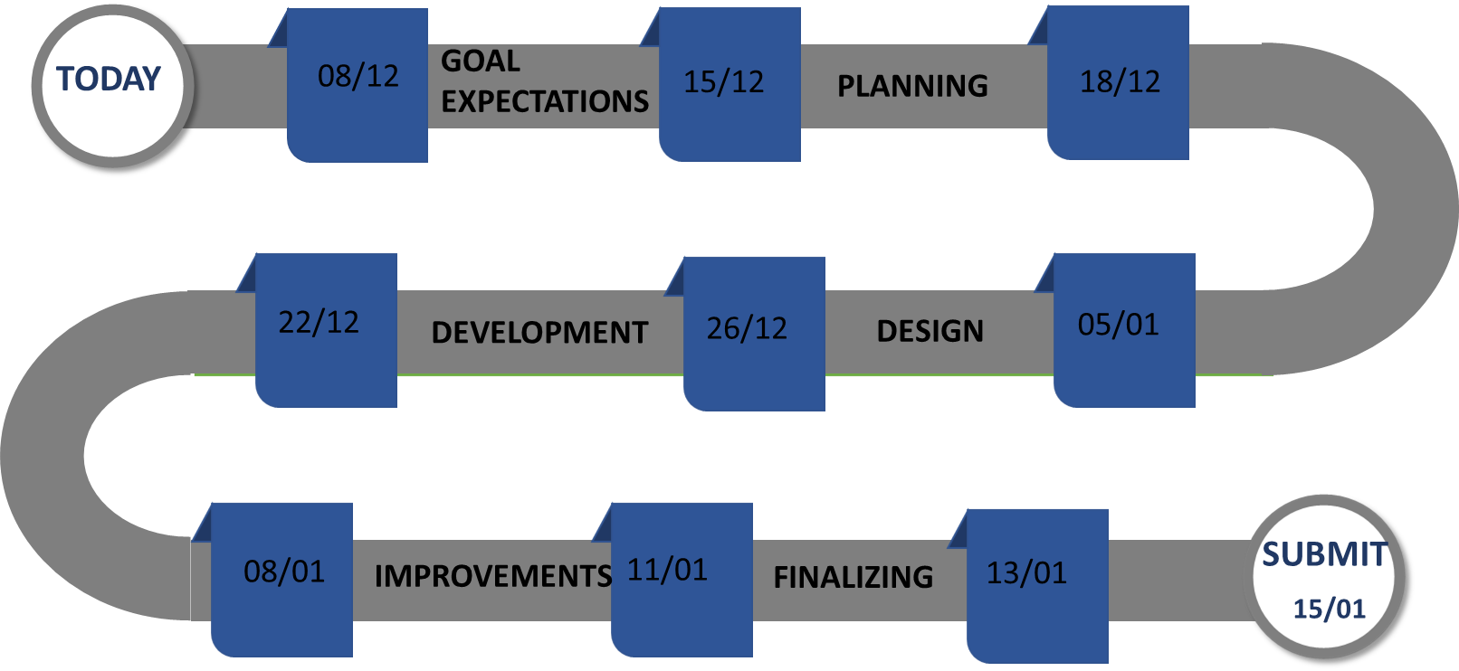
WEB DEVELOPMENT G10
ROADMAP

